Slide 1
What Every Serious Christian Should Know About Judaism
Rabbi Michael Lotker
Community Rabbi,
The Jewish Federation of Ventura County
Camarillo, California

Slide 2
Relationship Between
Christianity & Modern Judaism
BIBLICAL JUDAISM
Text: The Hebrew Bible
CHRISTIANITY
Event: Arrival of Jesus as God/Messiah/Redeemer of Sin
(c 30 CE )
Text: The Hebrew Bible & The New Testament
RABBINIC JUDAISM
Event: Destruction of the 2nd Temple (70 CE)
Text: The Hebrew Bible & The Mishna and Talmud.

Slide 3
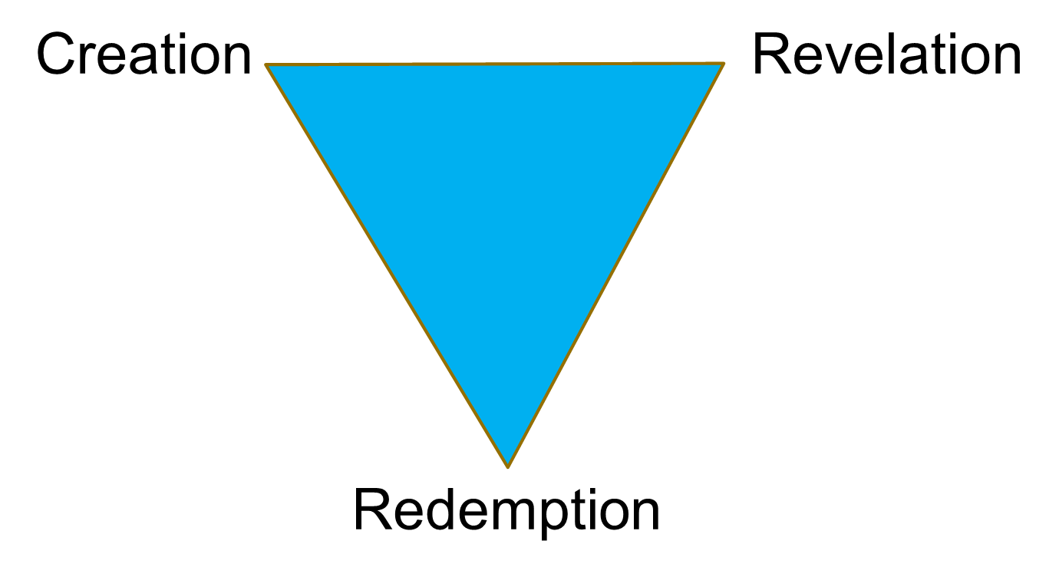
On the Nature of Judaism
God
Torah
Israel

Slide 4
Faith & Works
Emphasis on Judaism is Actions
  Commandments
  Jewish Law
  Faith is Important but Secondary
Emphasis in Christianity is Faith
  Acceptance of Jesus
  But Faith Without Works is Dead

Slide 5
Jewish Peoplehood
In ancient times, one’s religion and nationality were the same.
  Romans worshiped Roman gods.
  Egyptians worshiped Egyptian gods.
  Greeks worshiped Greek gods.
  And Israelites worshiped the Israelite God.
Judaism is the sole survivor of this system.
  Not every Jew is an Israeli.
  But every Jew is a member of Am Yisrael, the people Israel.

Slide 6
Who Is a Jew?
Biblical: Goes with Father’s line.
  Joseph marries daughter of Egyptian priest.
  His sons become heads of tribes.
Talmudic (& Current Traditional Law)
  You are Jewish if your mother is Jewish.
  Your beliefs don’t matter.
But anyone can convert to Judaism (although converts are not sought).
Reform Position: Child of Jewish father or mother is Jewish if raised Jewishly.

Slide 7
Jewish Sacred Texts Beyond the Bible
* Approximate Dates of Canonization

Slide 8
The Sabbath in the Torah: Exodus 20
20:8 Remember the Sabbath day, to keep it holy.
20:9 Six days shalt thou labor, and do all thy work:
20:10 But the seventh day is the sabbath of the LORD thy God: in it thou shalt not do any work, thou, nor thy son, nor thy daughter, thy manservant, nor thy maidservant, nor thy cattle, nor thy stranger that is within thy gates:
But how does God define work?

Slide 9
The Sabbath in the Mishna & Talmud
MISHNAH (Shabbat 2:2) The primary labours are forty less one, [viz.:] Sowing, ploughing, reaping, binding sheaves, threshing, winnowing, selecting, grinding, sifting, kneading, baking, shearing wool, bleaching, hackling, dyeing, spinning, stretching the threads, the making of two meshes, weaving two threads, dividing two threads, tying [knotting] and untying, sewing two stitches, tearing in order to sew two stitches, capturing a deer, slaughtering, or flaying, or salting it, curing its hide, scraping it [of its hair], cutting it up, writing two letters, erasing in order to write two letters [over the erasure], building, pulling down, extinguishing, kindling, striking with a hammer, [and] carrying out from one domain to another: these are the forty primary labours less one.
GEMARA (Shabbat 73b) Why state the number? — Said R. Johanan: [To teach] that if one performs them all in one state of unawareness, he is liable on account of each separately.

Slide 10
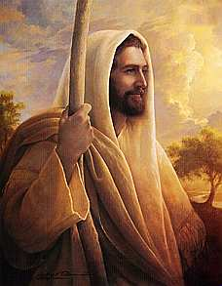
Judaism and Jesus
Why Don’t Jews Accept Jesus as the Messiah?

Slide 11
The Word “Messiah”
English “Messiah” is a translation of the Hebrew “Mashiach” [jhan]
Mashiach means “anointed.”
  Kings of Israel were anointed by pouring holy oil on their heads.
When the Hebrew Bible was translated into Greek (about 200 BCE), the Hebrew Mashiach became the Greek “Christos” [Χριστός].
The Greek Christos gives rise to the English “Christ.”

Slide 12
Jewish Understanding of Messiah
Fully Human and Only Human
A Political and/or Military Ruler like King David
Not God in any sense
Not the son of God in any sense beyond the idea that we are all children of God
Not connected with redemption of sin
  Only we can atone for our sins
  For sins against God, God forgives
  For sins against others, God cannot forgive unless the person offended forgives
Messiah not at the heart of Judaism

Slide 13
Jewish Prophecies Concerning Messiah
A time of peace on earth
  Peace among people
  Peace among animals
All the world will come to know the one God
Details unresolved
  Mystics see the time as supernatural
  Rationalists believe that we will do the work to make the world perfect
  Many believe in a Messianic Age rather than an individual Messiah.

Slide 14
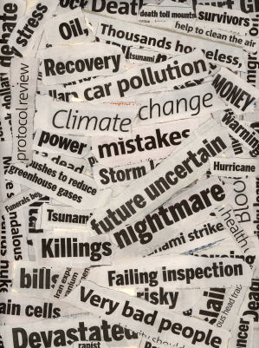
My “Has the Messiah Come?” Test
Read the LA Times cover to cover every day for a month.
If there’s no story of war, or hatred or hunger or disease, the Messianic Age may be here!

Slide 15
Why Don’t Jews Accept Jesus As Messiah?
No world peace, no Messiah
The Second Coming not a Jewish idea
The larger issue is whether Jesus is God
  The idea of God taking human form, suffering with us and dying for our sins is
    Beautiful and inspiring
    But not Jewish!
This is why I can have great respect for Christianity but less sympathy for “Jews for Jesus” and “Messianic Jews”
This issue is not “Who was Jesus” but “ Who is God.”

Slide 16
A Religion of Commandments
Hebrew for Commandment = Mitzvah
  Bar/Bat Mitzvah is someone obligated to observe commandments
Not just the big 10
613 commandments in the Torah alone!
  Love thy neighbor
  No pork
  Paying wages to day laborers each day

Slide 17
How Many Commandments?
613 in the Torah [1st 5 Books of Bible]
The Rabbis of the Talmud add 1000s more
  Against mixing milk and meat
  Kosher slaughtering
  Shabbat candles
  Bar/Bat Mitzvahs
  Hanukkah candles
  Detailed rules for Passover Seders
  Daily prayers

Slide 18
Jewish Movements
Orthodox: All Jewish law unchanging & binding on all Jews.
  Hasidic & Chabad are well known examples
Conservative: All Jewish law binding on all Jews but laws change with the times.
  Example: OK to drive to synagogue on Shabbat.
Reform: Ethical Jewish laws binding but ritual laws (head coverings, kosher laws, Sabbath observance) should be studied and each individual decides if s/he hears God’s voice.

Slide 19
Jewish Contributions to the World
The Bible – First System of Ethics & Monotheism
Ten Commandments
Ideas like “Love thy
Neighbor as Yourself”
lunf lgrk ,cvtu
Judeo Christian Heritage founded on Jewish ideas
740 Nobel Prizes
Between 1901 and 2004 - 156 are Jews
Medicine – 29%
Chemistry – 19%
Economics – 38%
Physics – 26%
Peace – 10%
From Joseph Sonnenblick

Slide 20
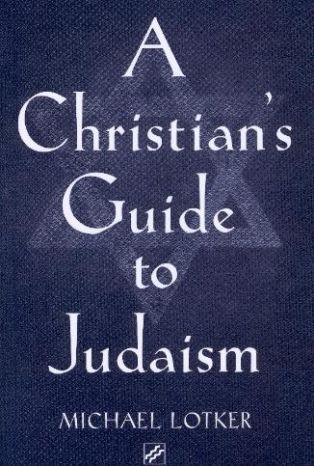
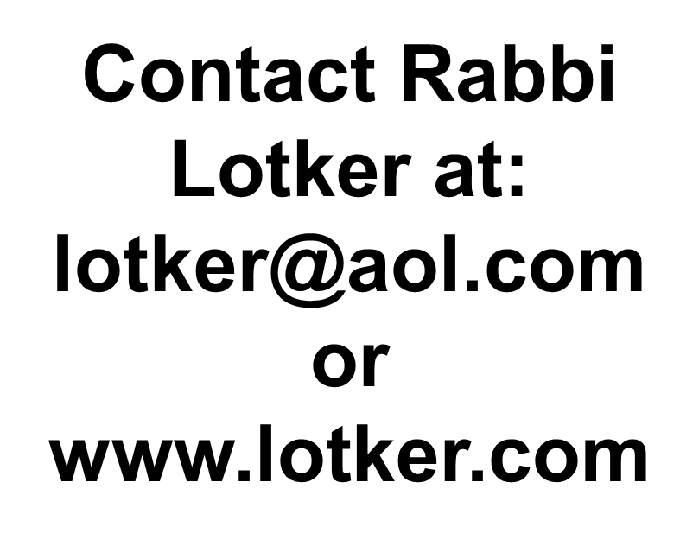
Want to Learn More?
Paulist Press, 2004

